Slide 1
Personal Project

Slide 2
The Brief
To create an OOP-based application with utilisation of supporting tools, methodologies and technologies that encapsulate all core modules covered during training.

Slide 3
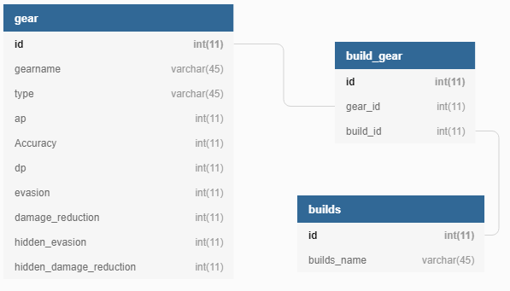
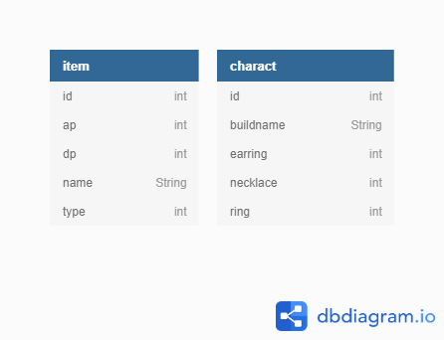
Solution
Make a Build Planner for Black Desert online
Initial Plan – Relational Database with 3 Tables
Delivered Solution – 2 Tables No Relationships

Slide 4
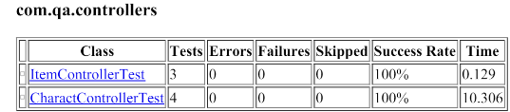
Testing
Unit Testing with Junit
Database Testing Mockito
Selenium
Sure-fire Report

Slide 5
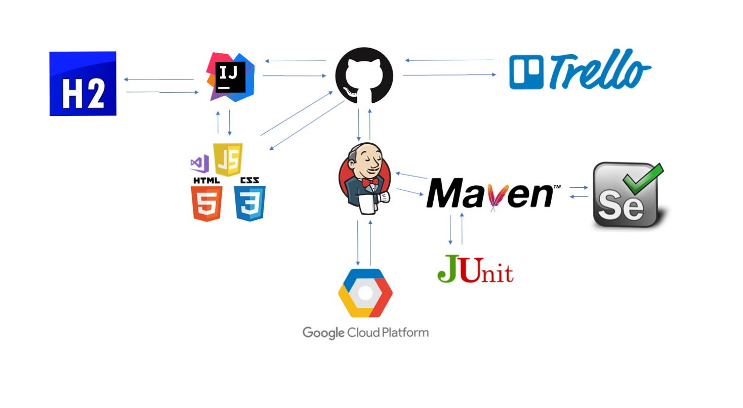
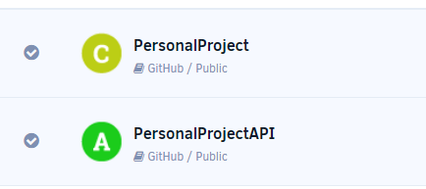
Deployment
H2 Database, API and Front end deployed on GCP instance
Webhook from Jenkins to auto deploy new code when I push to GitHub
Commands are executed from a jenkinsfile located on GitHub
Back end built on a Spring REST API

Slide 6
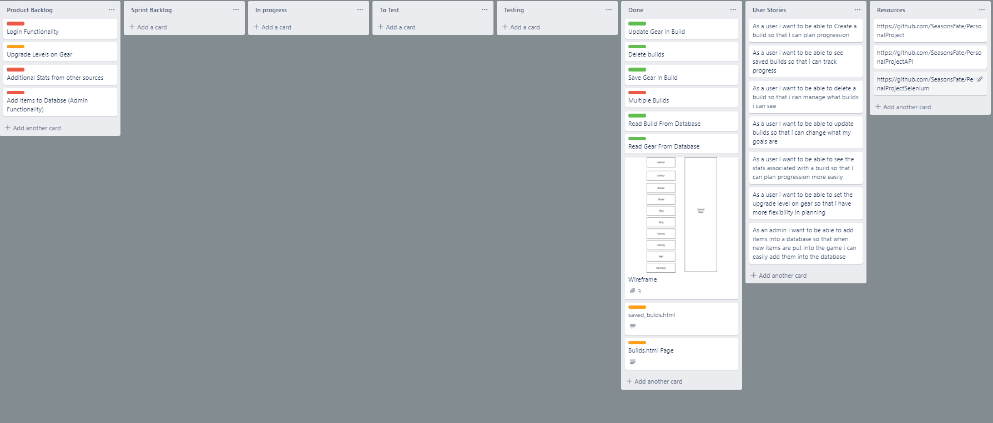
Trello
Used Trello to plan and manage development in the Project
Used RAG to prioritise tasks

Slide 7
Live Demo
http://35.246.117.181/builds.html

Slide 8
Improvements For Future
Change database to relational
Add Table to database to have upgrade levels on gear
Login Functionality

